Slide 1

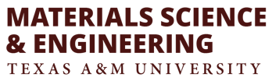
Phase-field simulation of solidification morphology
in laser powder bed fusion of Ni-based Binary Alloys
Xueqin Huang
09/05/2019

Slide 2
Outline
Background:
Additive Manufacturing
Motivation
2. Framework:
Thermal Model
PFM
3. Result: Ni-Nb, Ni-Cu, Ni-Al
Notes:
This is the outline. In the first section, it’s the background like what additive manufacturing is and the motivation for microstructure prediction on the AM material. Then the second part is about the framework using the thermal model and PFM to predict the microstructure at different location on the melt pool. Finally, some results of microstructure predictions for Ni-based binary alloy, NiAl, NiCu and NiNb using the model will be compared and discussed.

Slide 3
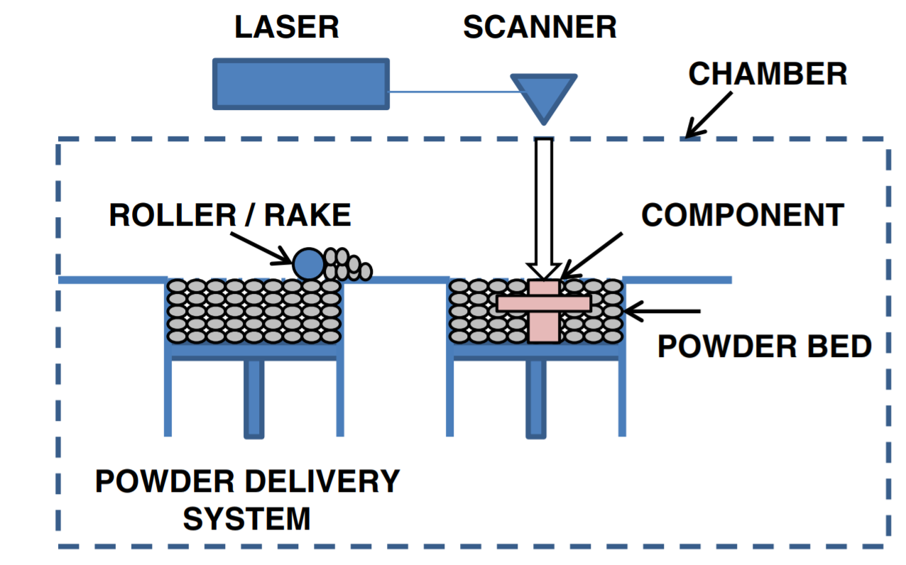
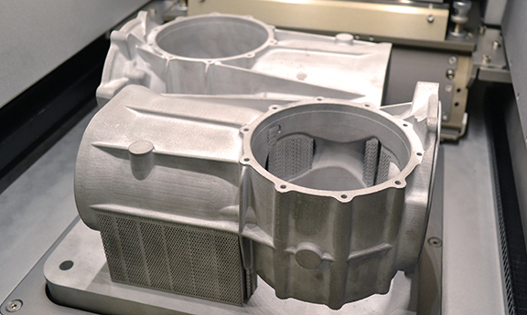
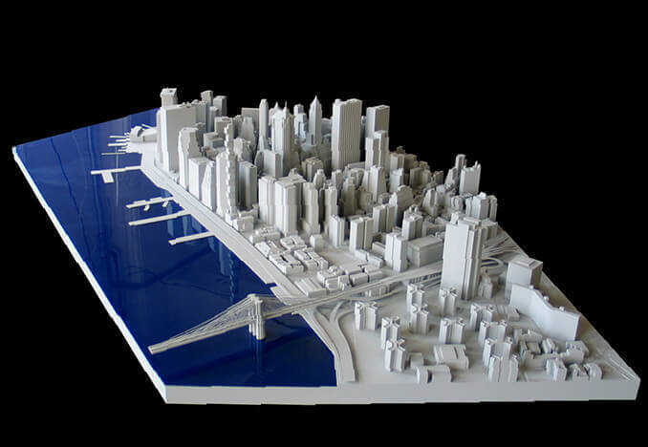
Background: Additive Manufacture
Application:
Lightweight Machines[2]
Architectural Modelling[3]
AM powder bed system[1]
Medical Applications
[1] Frazier, et al. Journal of Materials Engineering and Performance (2014)
[2] All3DP
[3] J. Pellettieri, et al., Lightweight World
Notes:
This is what Am powder bed system looks like. The energy source (usually a laser beam) is programmed to deliver energy to the surface of the bed melting and sintering the powder into the desired shape. Additional powder is raked across the work area, and the process is repeated to create a solid three dimensional component.
With additive manufacturing technologies it is possible to manufacture lightweight parts for the automotive and aerospace industry, while securing safety. Also, the technology can be used in architectural modelling and medical application.

Slide 4
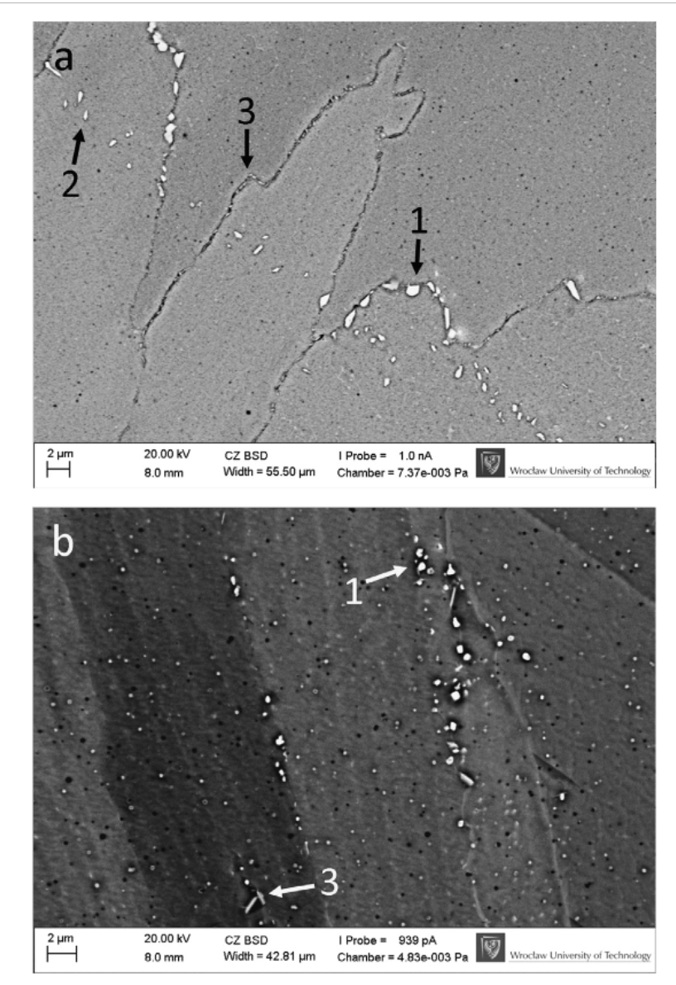
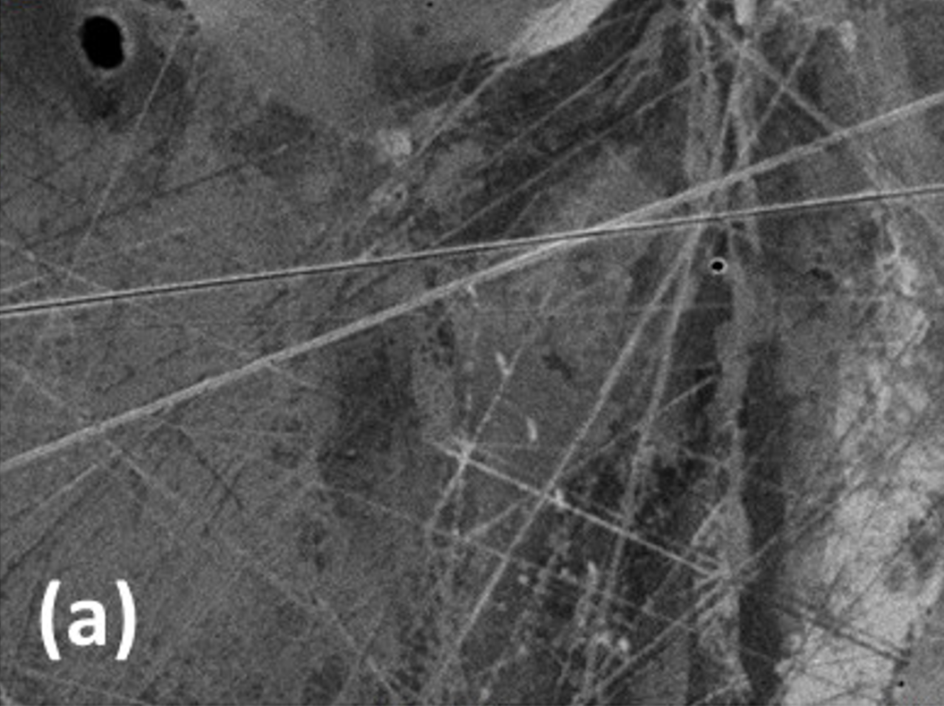
Motivation
microstructural consistency
(b)
Planar [1]
Cellular/Dendritic[1]
Illustration of remaining second phases at grain boundaries of a SLM Inconel 718[2]
Different Microstructure with different process Parameter
Printability parameter: frozen zone, thermal conductivity, segregation coefficient, laser power,
laser velocity
Printable range:
Avoid undesirable microstructure
Avoid Balling, LOF, Key hole
(Printability Map)
[1] Raiyan Seede
[2] Chlebus, E., et al. Materials Science and Engineering (2015)
Notes:
In the additive manufacturing, there exists the high cooling rate solidification process, due to the high laser power and laser speed, so the microstructure of the material is not only affected by the materials’ properties, but also by the process parameters, here are the laser power and laser velocity. From the left side of the slides, we can see two most common structure for NiNb with different process parameter, planar and cellular. And the right side’s figures shows For Inconel 718, under the non-equilibrium conditions in AM, Nb tends to segregate to interdendritic regions, favoring the precipitation of a metastable Laves phase or the delta phase, both of which result in reduction of ductility and fatigue resistance.
So to guarantee the performance of AM parts, the microstructural consistency is important. Our main goal is to find the connection between printable range and the printability parameter like ,material’s properties and the process parameters. The printable range needs to avoid undesirable microstructure and phases and avoid the balling, LOF and the key hole range.

Slide 5
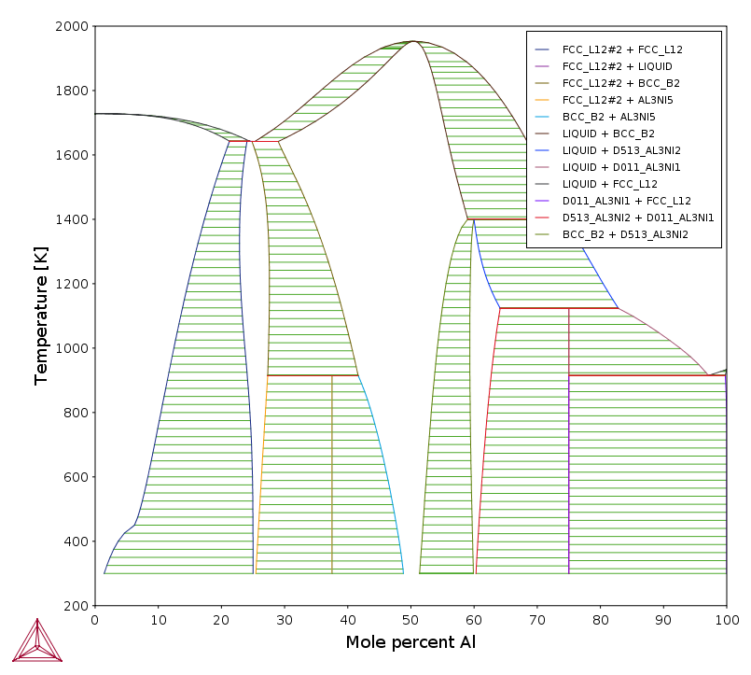
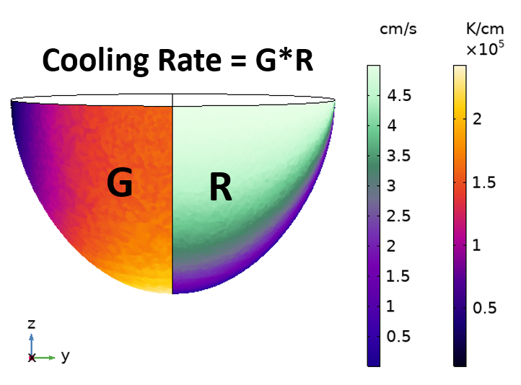
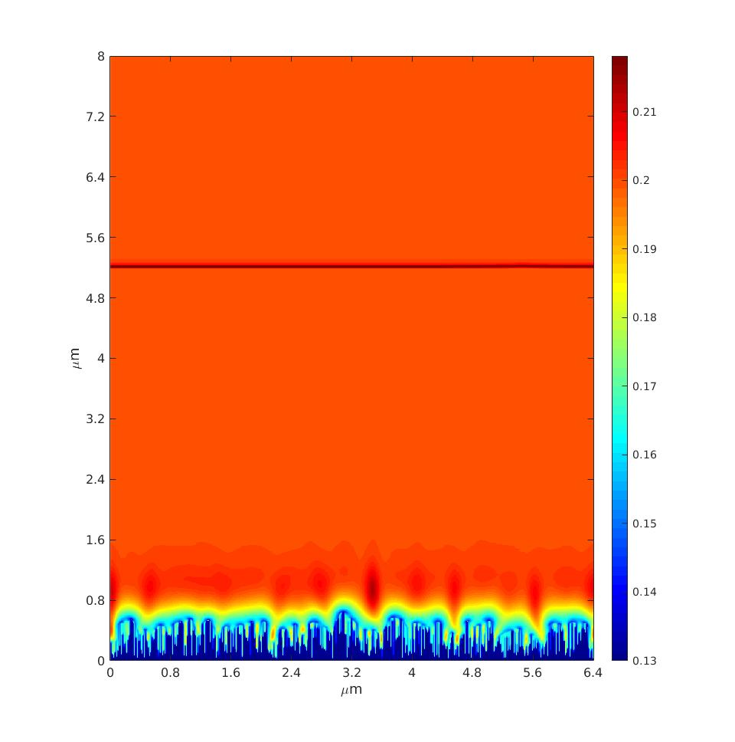
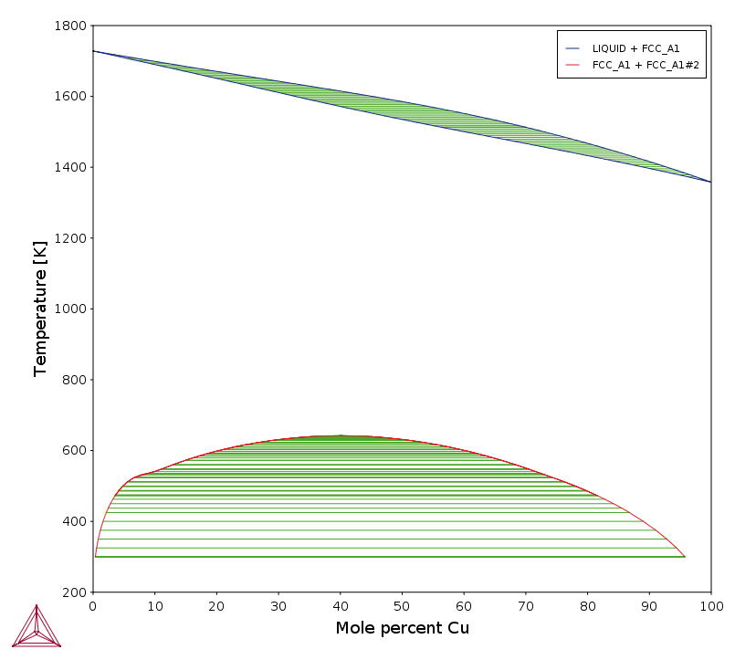
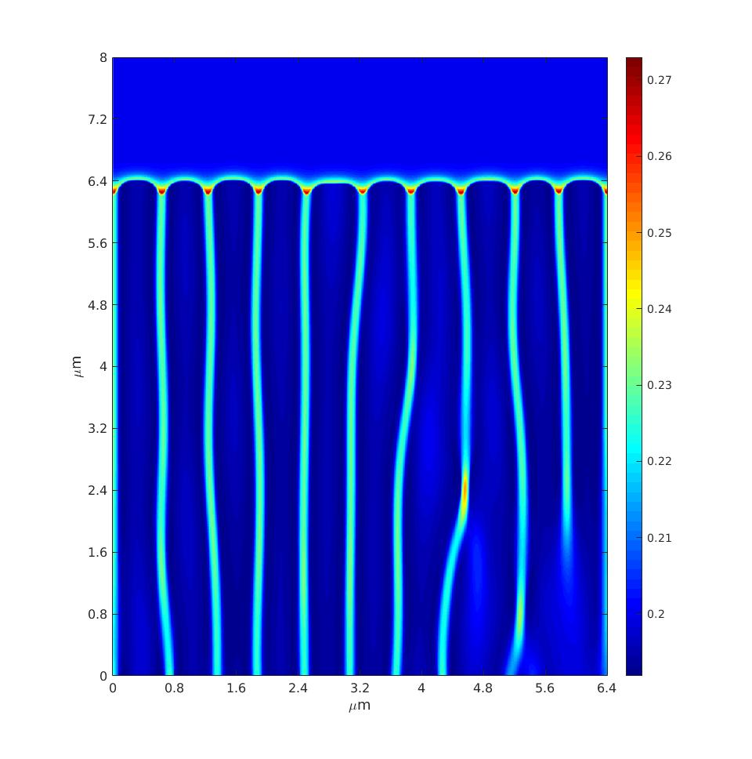
Framework
Process
parameters:
Laser speed,
Laser power,
Dissipation
Phase-Field
Model: Microstructure
(planar, cellular/dendritic)
Thermal Model:
Solidification velocity, temperature gradient,
Melt pool dimension
Material parameters:
Notes:
The frame work to predict the microstructure at different location in the melt pool is showed on the slide. The first step is to use the thermal model to obtain the solidification velocity and temperature gradient of different parts in the melt pool. The inputs for the thermal model are the process parameters, laser velocity and laser power, and the material parameters, like the thermal conductivity. And with the output of thermal model, the solidification velocity and temperature gradient, and the Gibbs free energy of the material, the dissipation PFM can be used to predict the microstructure, like planar or cellular.

Slide 6
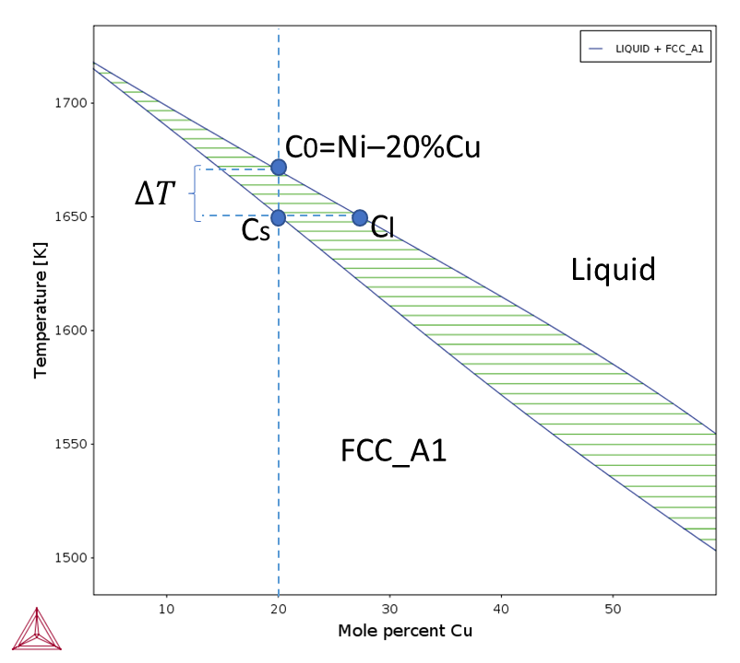
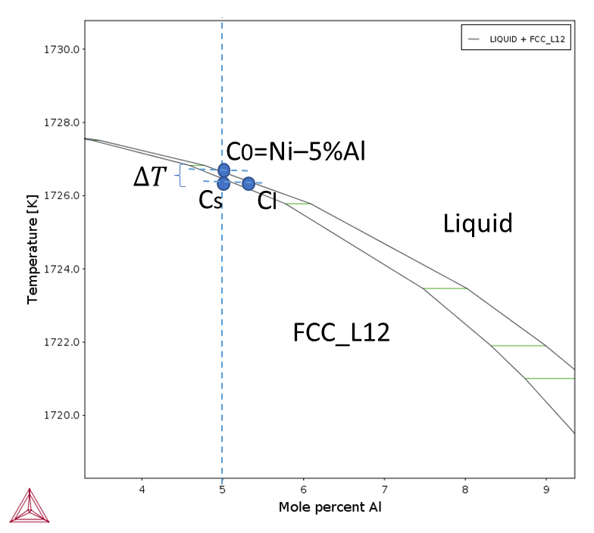
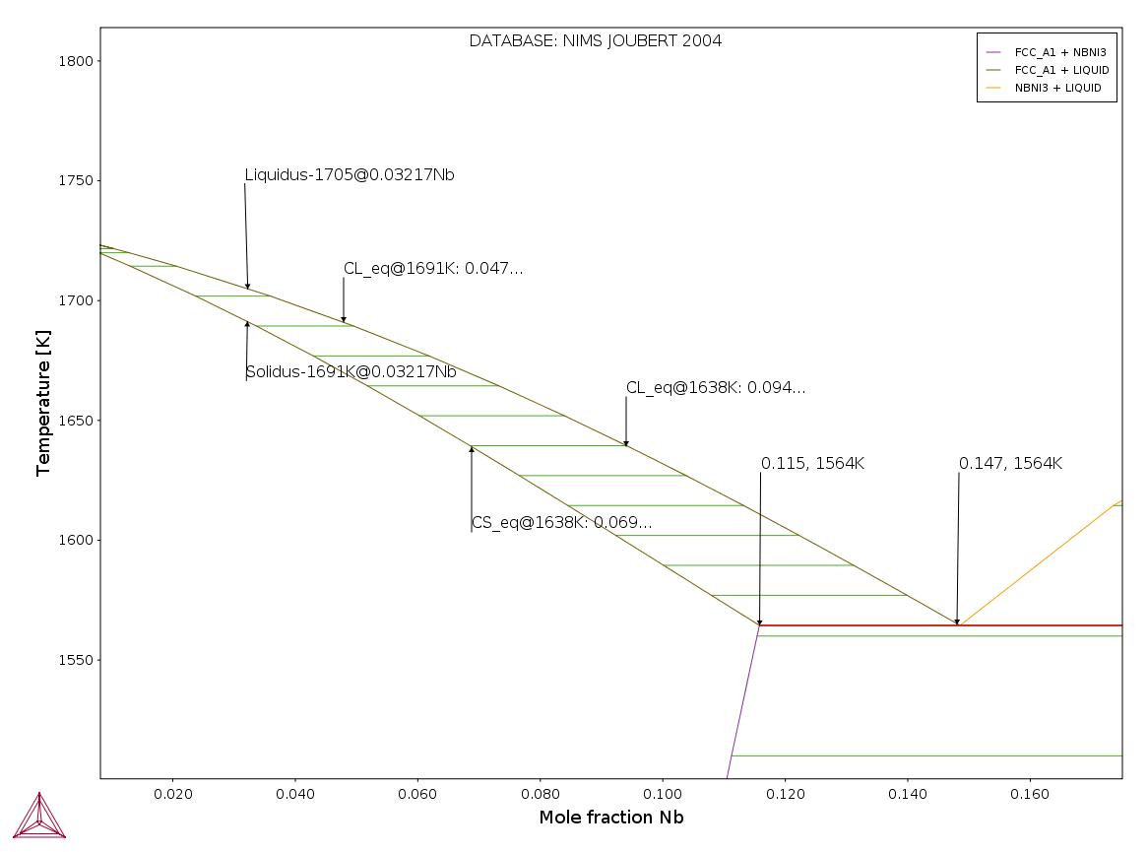
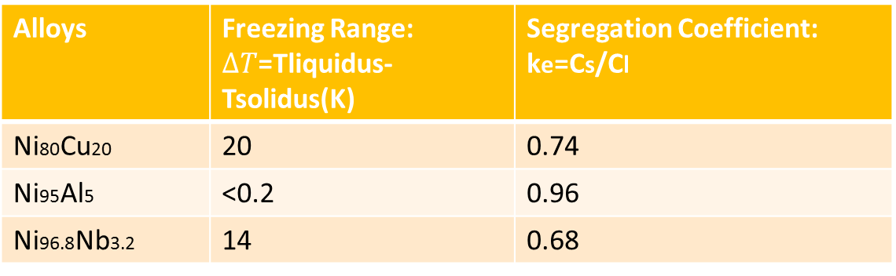
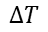
Material Properties:
Ni95Al5
Ni80Cu20
Ni96.8Nb3.2
C0=Ni–3.2%Nb
Liquid
$$∆T$$
FCC_A1
Alloys | Freezing Range: $∆T$=Tliquidus- Tsolidus(K) | Segregation Coefficient: ke=Cs/Cl
Ni80Cu20 | 20 | 0.74
Ni95Al5 | <0.2 | 0.96
Ni96.8Nb3.2 | 14 | 0.68
Notes:
To compare different materials, this slides shows some of their propertis. with the same solidification velocity and temperature gradient, the microstructure is mainly affected by the material properties, like the phase diagram. The material we choose are Ni95Al5, Ni96.8Nb3.2 and Ni80Cu20, since the phases are simple in these cases and the freezing range are different.

Slide 7
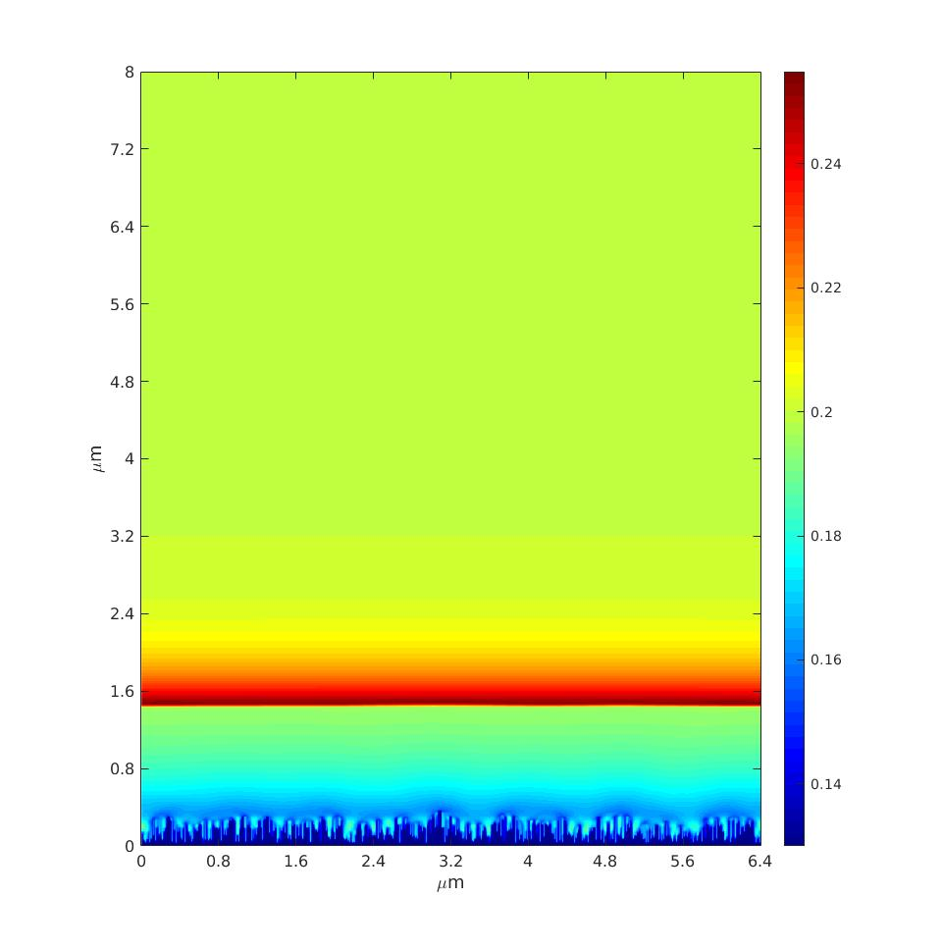
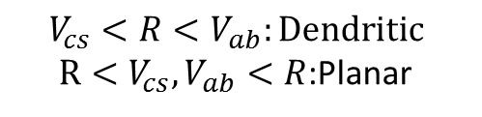
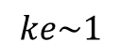
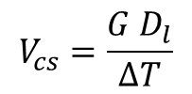
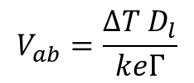
Planar
Criteria
$$V_{cs}<R<V_{ab}:Dendritic$$
$R<V_{cs}, V_{ab}<R$:Planar
Constitutional supercooling
criterion:
A volume of the liquid at the interface is undercooled, which acts like a driving force for the development of perturbation
Dendritic
$$V_{cs}=\frac{{G D}_{l}}{∆T}$$
Absolute stability criterion:
Atoms have no time to rearrange
Planar
$$V_{ab}=\frac{∆T D_{l}}{keΓ}$$
$$ke\sim 1$$
Notes:
So how the process parameter and the material properties will change the microstructure? Here is one simple criteria. For the selected alloy composition under the laser powder bed fusion process with varying P and V, two types of growth morphologies, planar and cellular, are predicted. As the growth rate increases, a transition from planar to cellular and again to planar morphology is predicted. Usually with certain temperature gradient, when the solidification velocity locates between the Constitutional supercooling criterion and Absolute stability criterion, we tends to obtain the dendritic structure, otherwise, we will observe the planar structure. With the increase of the solidification velocity, we first see the planar structure, then since a volume of the liquid at the interface is undercooled, which acts like a driving force for the development of perturbation, we start to see dendritic structure and when the solidification velocity keep increasing, the atoms have no time to rearrange themselves, which meets the absolute stability criterion, we then see the planar structure and in this case the segregation coefficient is approaching one.

Slide 8
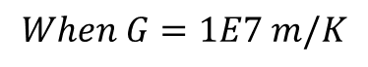
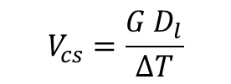
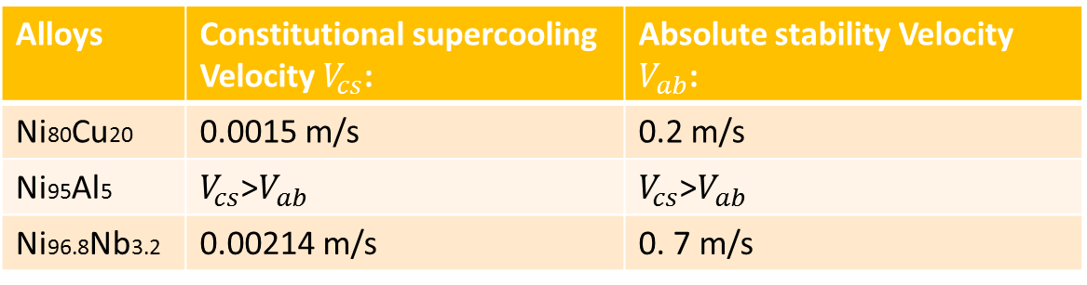
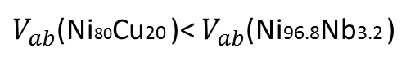
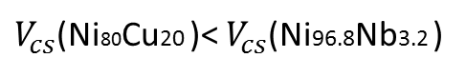
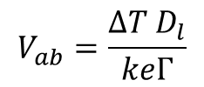
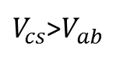
Predict Result:
Freezing range: Ni95Al5 < Ni96.8Nb3.2 < Ni80Cu20
Segregation coefficient: Ni96.8Nb3.2 < Ni95Al12 < Ni80Cu20
Interfacial Energy: Ni96.8Nb3.2 = Ni95Al12 < Ni80Cu20
$$V_{cs}=\frac{{G D}_{l}}{∆T}$$
$$V_{ab}=\frac{∆T D_{l}}{keΓ}$$
$$When G=1E7 m/K$$
Alloys | Constitutional supercooling Velocity $V_{cs}$: | Absolute stability Velocity $V_{ab}$:
Ni80Cu20 | 0.0015 m/s | 0.2 m/s
Ni95Al5 | $V_{cs}$>$V_{ab}$ | $V_{cs}$>$V_{ab}$
Ni96.8Nb3.2 | 0.00214 m/s | 0. 7 m/s
Narrow freezing range
Ni95Al12: Planar
$V_{cs}$>$V_{ab}$
large freezing range: >10K
Ni96.8Nb3.2, Ni80Cu20 : Planar, Dendritic
Freezing range: Ni96.8Nb3.2<Ni80Cu20
$V_{cs}$(Ni80Cu20 )< $V_{cs}$(Ni96.8Nb3.2 )
Interfacial Energy: Ni96.8Nb3.2<Ni80Cu20
$V_{ab}$(Ni80Cu20 )< $V_{ab}$(Ni96.8Nb3.2 )
Notes:
By the previous criteria, the constitutional supercooling velocity and the absolute stability velocity are calculated in the table, from where we can predict results. Since, for NiAl, the freezing range is so small, even smaller than 0.2 K, the absolute stability velocity is smaller than constitution supercooling velocity. So it is more likely that we can only see the planar structure for this material. For NiCu and NiNb, even though NiCu has larger freezing zone than NiNb’s, the interfacial energy for the NiCu is seven time larger than the NiNb, which means it is harder for NiCu to form finer dendritic structure at high solidification velocity , but it is easier for NiCu to be undercooled at the interface.

Slide 9
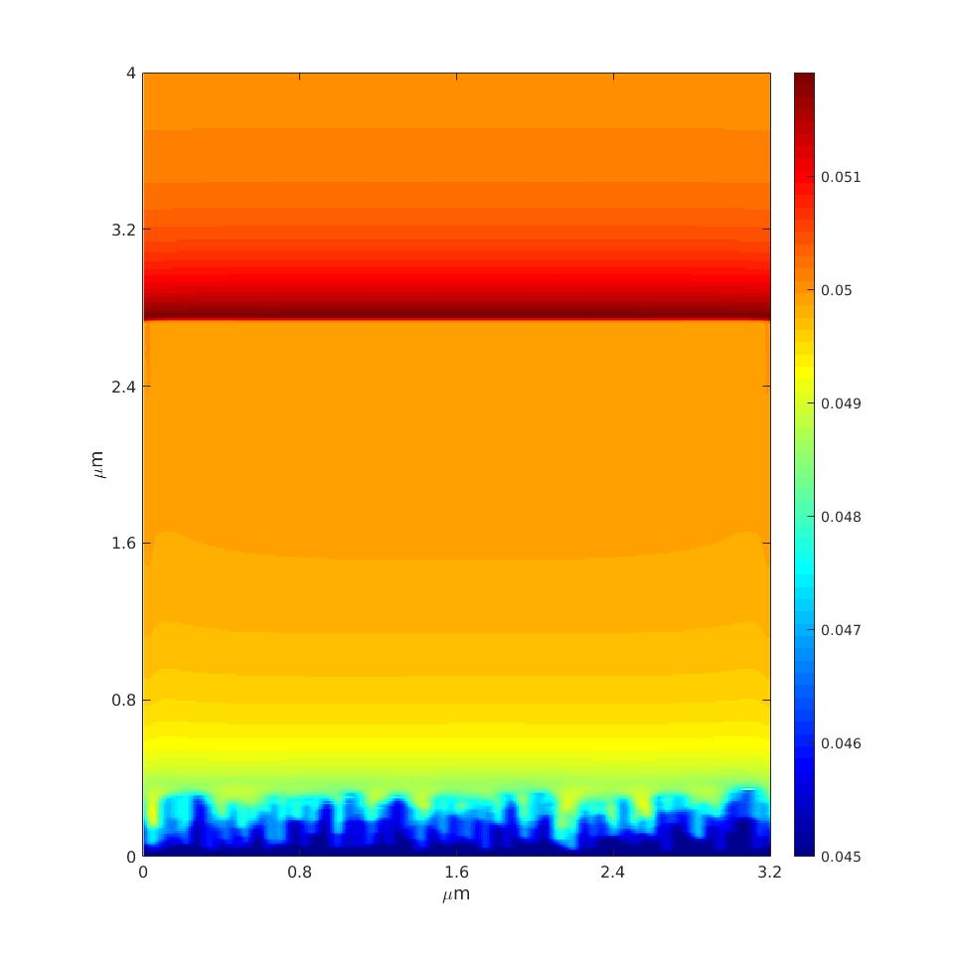
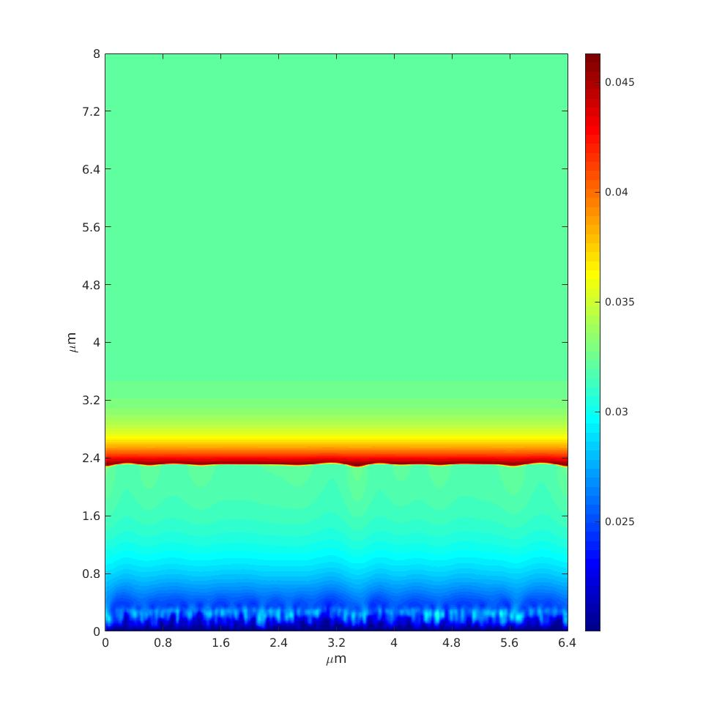







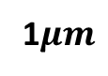

Result at low solidification velocity (G=2E7K/m, V=0.01m/s) :
Ni95Al5
Ni96.8Nb3.2
Ni80Cu20
$$R>V_{ab}$$
$$R<V_{cs}$$
$$R<V_{cs}$$
1$μm$
$$2μm$$
$$2μm$$
$$ke\sim 0.961$$
$$ke\sim 0.711$$
$$ke\sim 0.8$$
Notes:
From this slides, you can see some simulation results. With the low solidification velocity, we can only see planar microstructure. However, since the NiAl’s freezing range is very narrow, the solidification velocity is larger than absolute stability criteria, which can be verified by the segregation coefficient near 1.

Slide 10

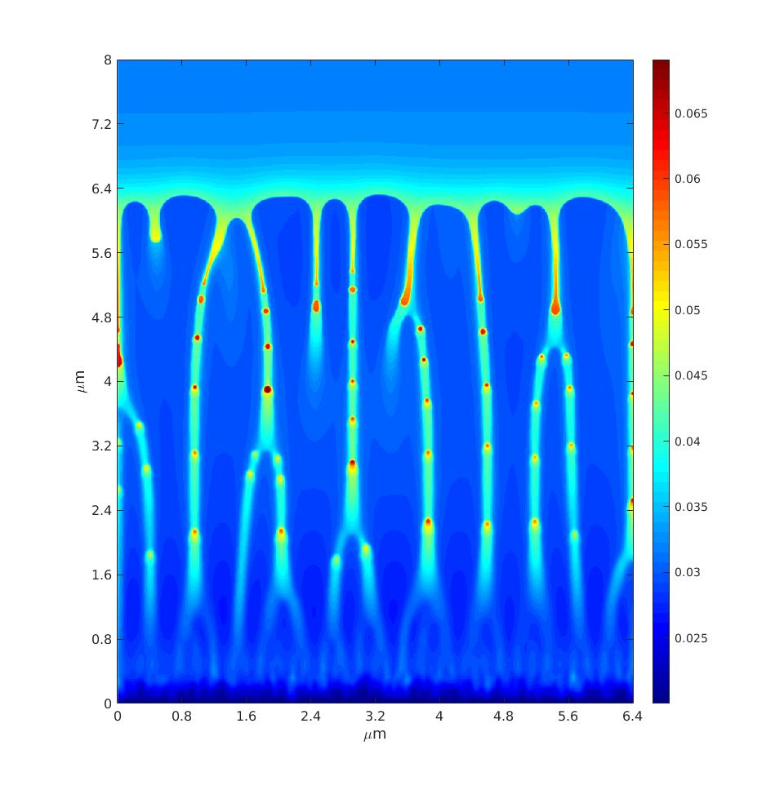
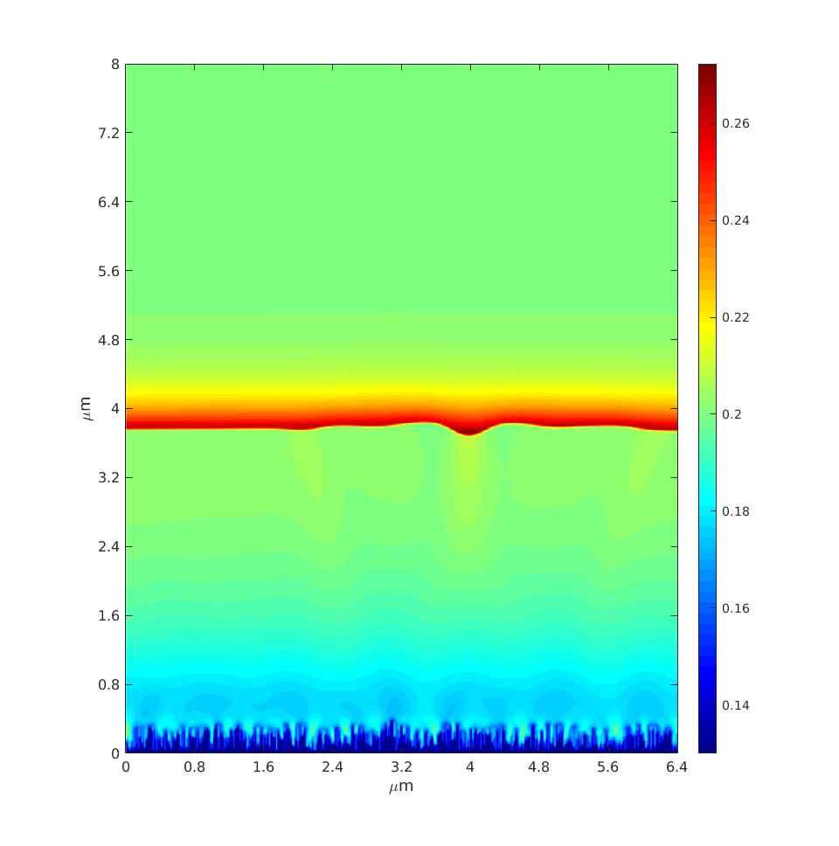

Result at medium solidification velocity (G=1E7K/m, V=0.01m/s) :
Ni95Al5
Ni96.8Nb3.2
Ni80Cu20
$$R>V_{ab}$$
$$V_{cs}<R<V_{ab}$$
$$R<V_{cs}$$
1$μm$
$$2μm$$
$$2μm$$
$$ke\sim 0.961$$
$$ke\sim 0.711$$
$$ke\sim 0.8$$
Notes:
At the medium solidification velocity, NiNb is the first one to form the dendritic structure, but not NiCu, even though the NiCu has larger freezing range, which means there will more perturbation at the interface. The reason for this is the interfacial energy for NiCu is much larger than the NiNb, which means Nicu takes more energy to form a high curvature structure.

Slide 11
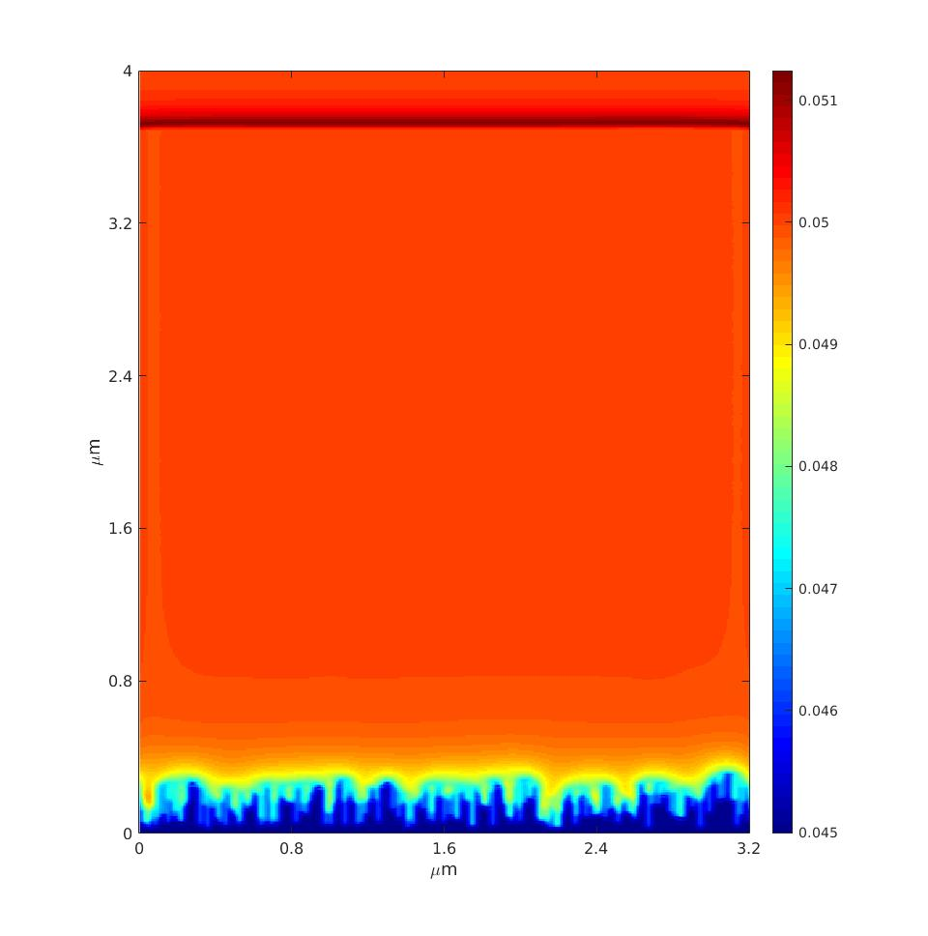
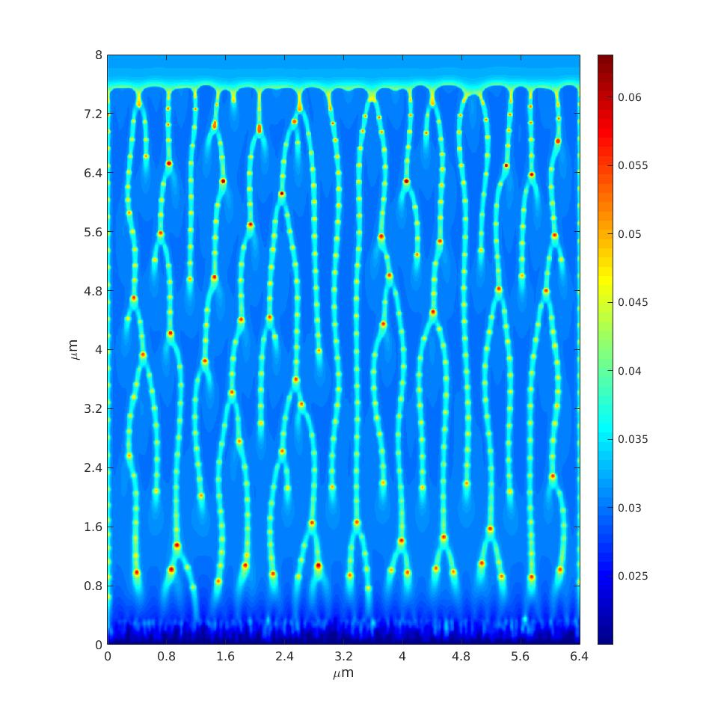



Result at medium solidification velocity (G=1E7K/m, V=0.05m/s) :
Ni95Al5
Ni96.8Nb3.2
Ni80Cu20
$$R>V_{ab}$$
$$V_{cs}<R<V_{ab}$$
$$V_{cs}<R<V_{ab}$$
1$μm$
$$2μm$$
$$2μm$$
$$ke\sim 0.98$$
Notes:
With the increase of solidification velocity, we can only see the planar structure for NiAl, while, for the NiNb and NiCu, the dendritic structure can be observed. Comparing the NiNb and NiCu, NiNb has finer structure than NiCu, which mean the interdendritic distance for NiNb is smaller than NiCu. It is also because NiCu has the higher interfacial energy, that is it takes more energy for NiCu to form high curvature structure.

Slide 12
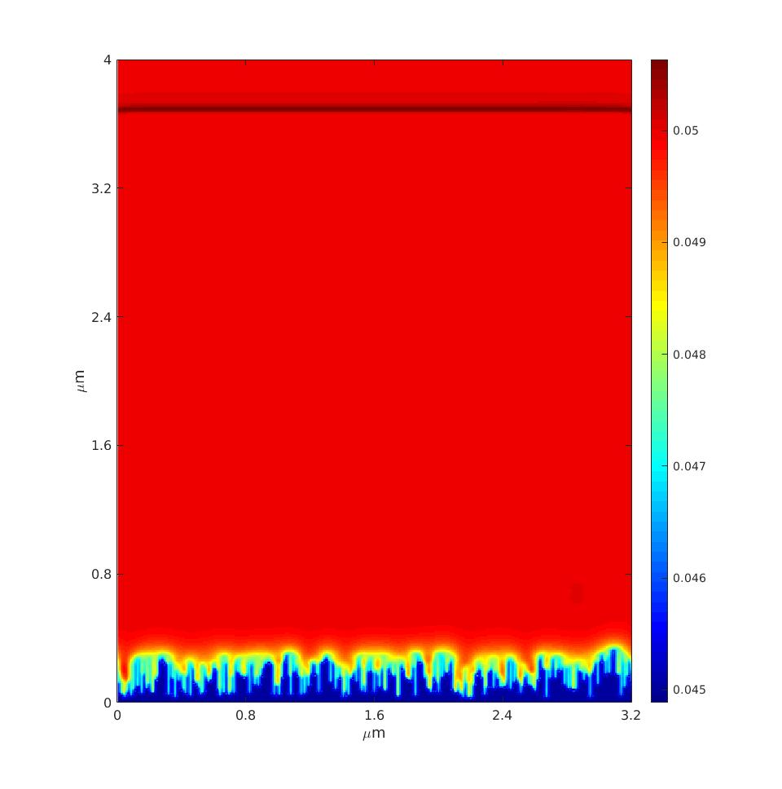
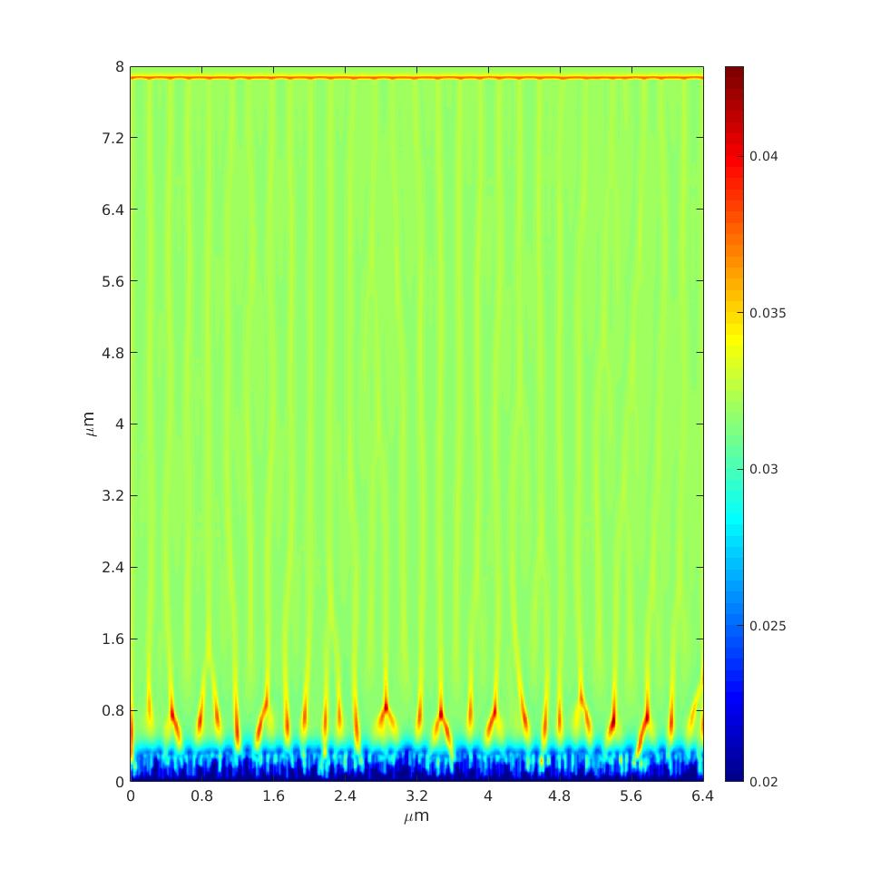





Result at high solidification velocity (G=2E7K/m, V=0.15m/s):
Ni95Al5
Ni96.8Nb3.2
Ni80Cu20
$$R>V_{ab}$$
$$V_{cs}<R<V_{ab}$$
$$R>V_{ab}$$
1$μm$
$$2μm$$
$$2μm$$
$$ke\sim 0.99$$
$$ke\sim 0.98$$
Notes:
At high solidification velocity, for NiAl, not surprise, it is still in its absolute stability criteria range. But the dendritic structure can only be observed in NiNb again, even though it is very fine. The reason is that NiCu has the higher interfacial energy. So it is harder for NiCu to form super fine dendritic structure.

Slide 13
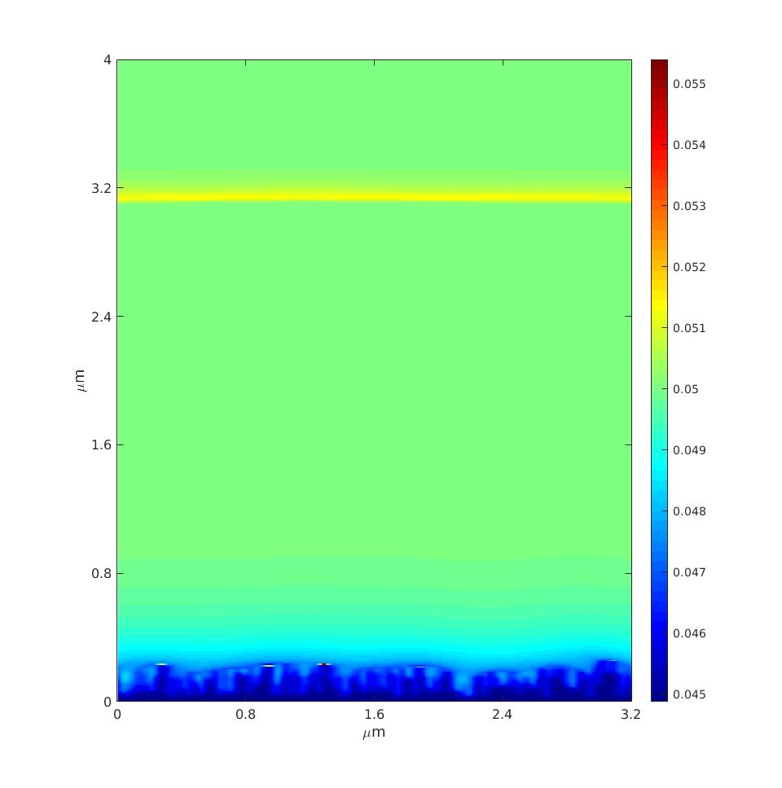
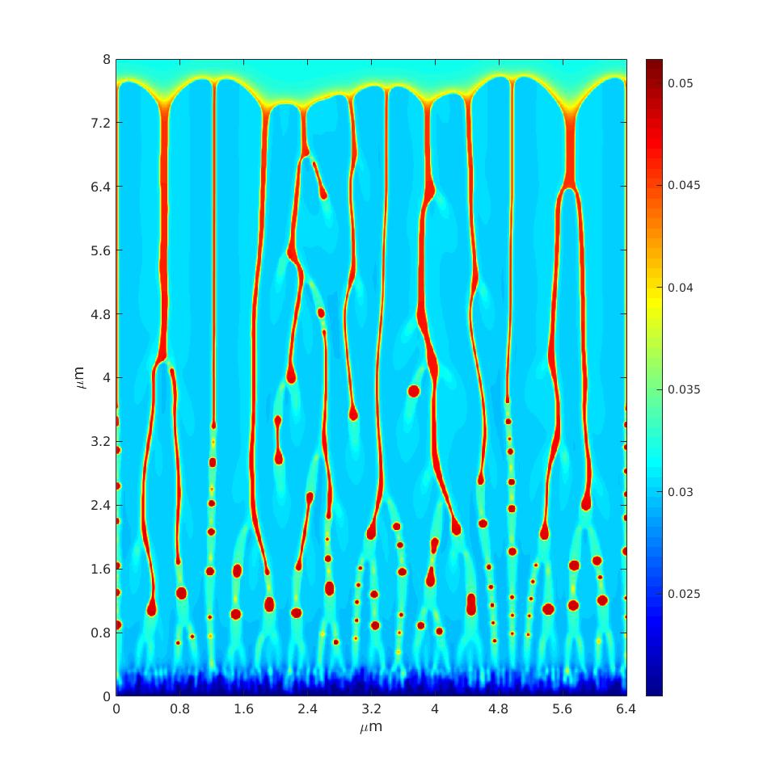
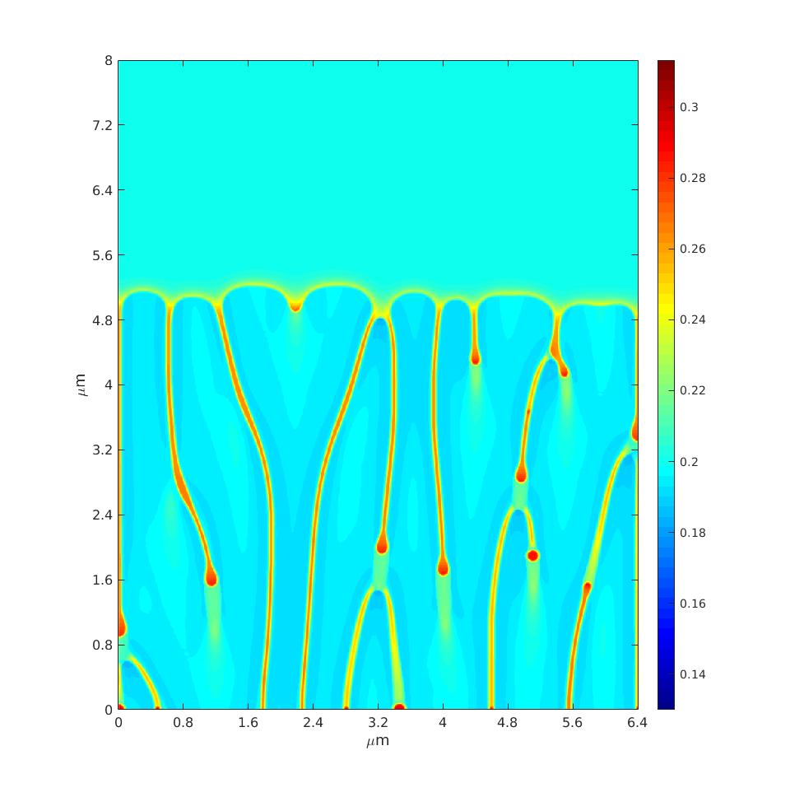
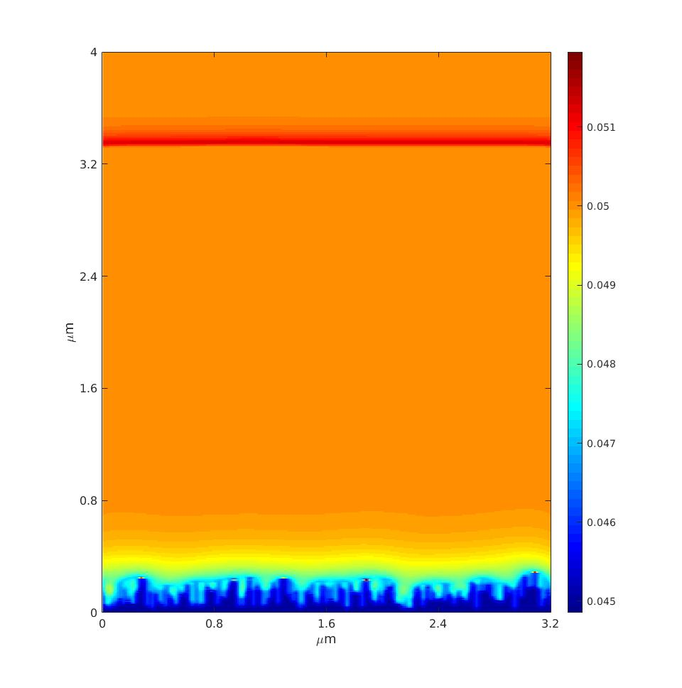
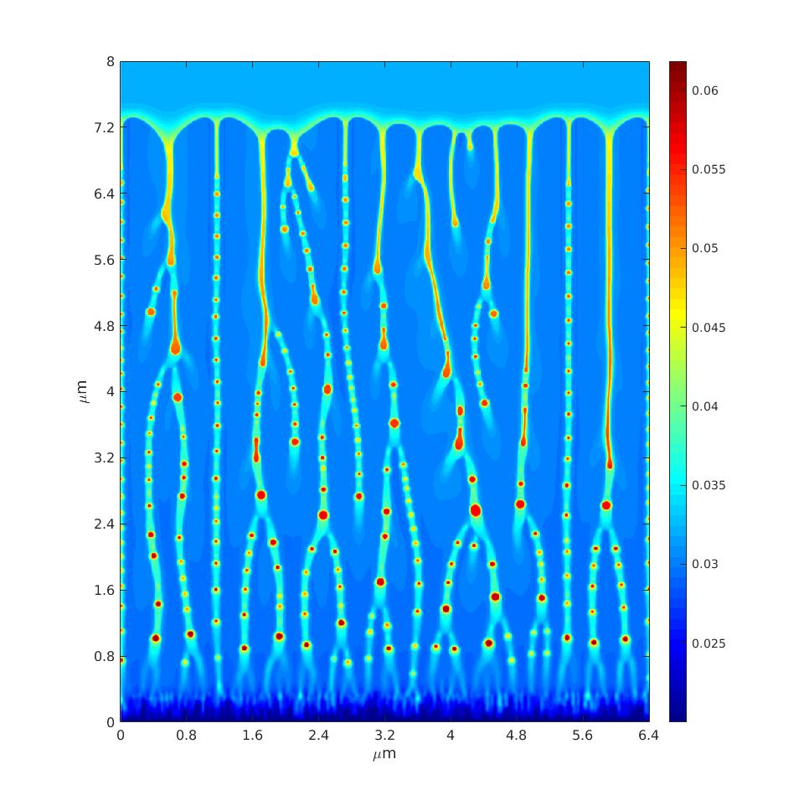
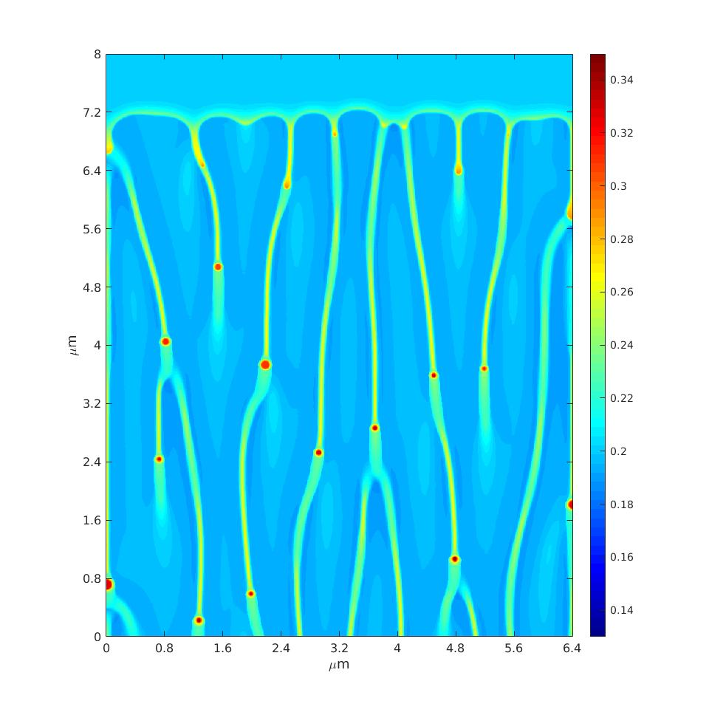
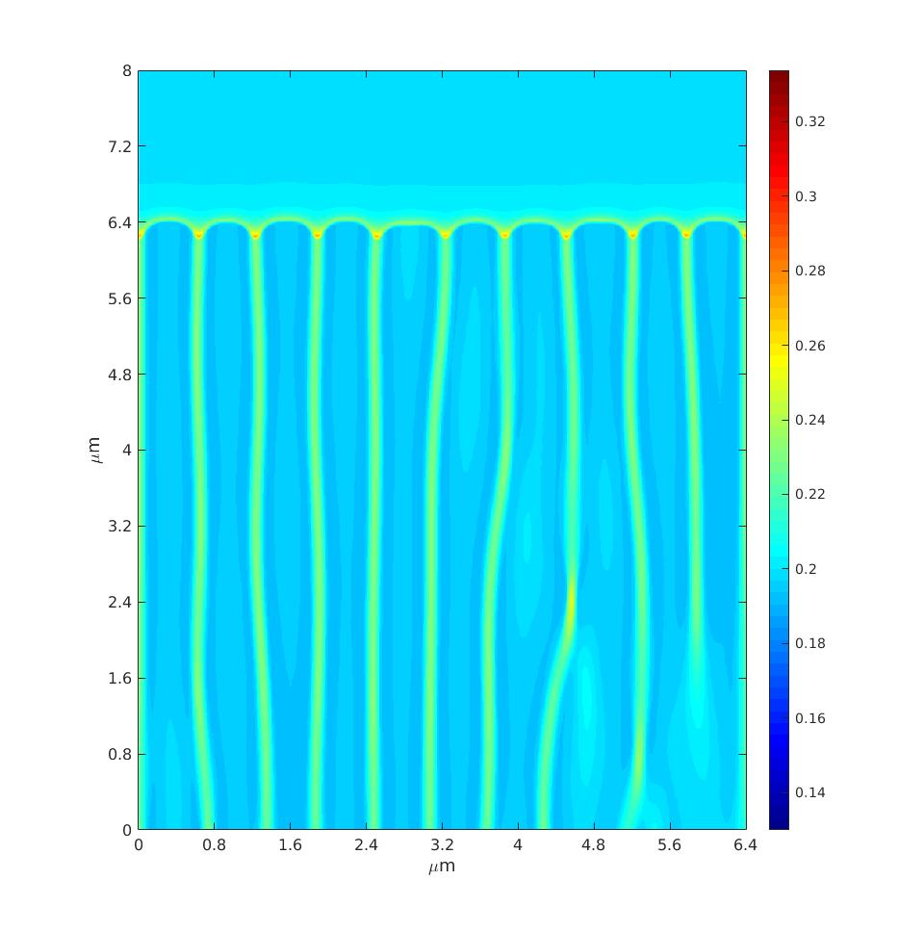
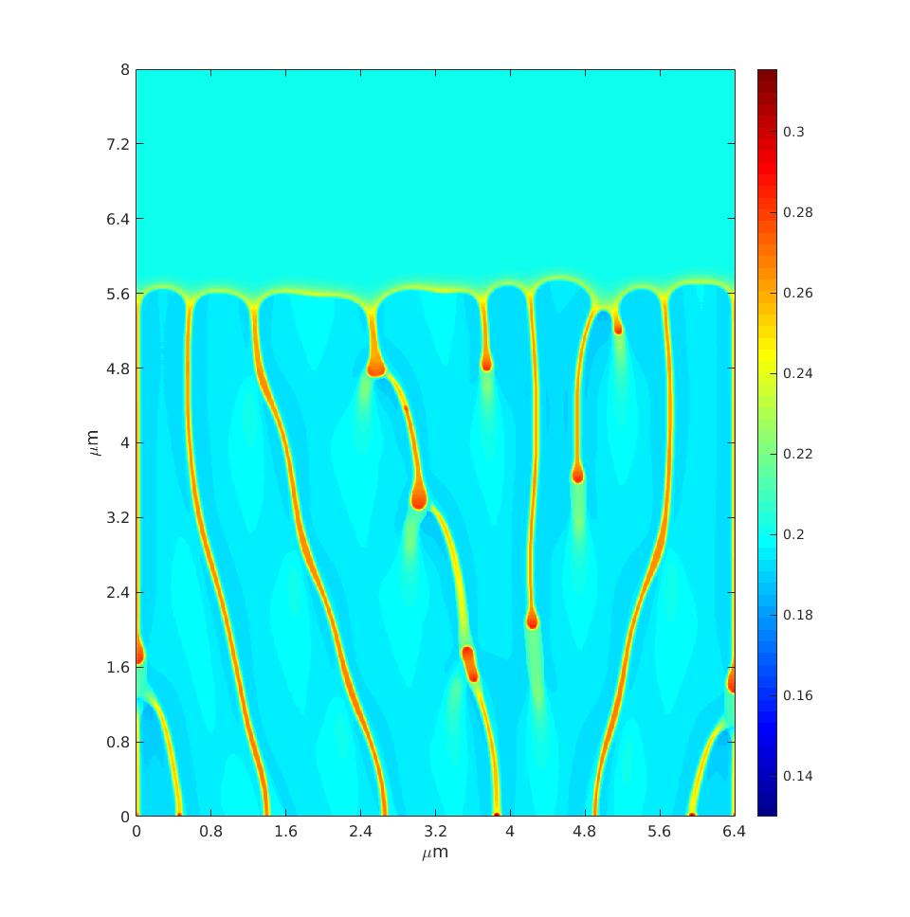


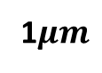






Result
Ni95Al5
Ni96.8Nb3.2
Ni80Cu20
G=3E5K/m,
V=0.05m/s
1$μm$
$$2μm$$
$$2μm$$
G=2E6K/m,
V=0.05m/s
1$μm$
$$2μm$$
$$2μm$$
G=1E7K/m,
V=0.05m/s
1$μm$
$$2μm$$
$$2μm$$
Notes:
This is a comparison between different material with increase of the temperature gradient, from where, we can see the NiAl keeps having planar structure. With the increase of the temperature, the interdendritic distance deceases and the interdendritic distance for NiCu is larger than NiNb’s, under the same process parameter.

Slide 14

Microstructure for cast Ni-Cu

Slide 15

Update for Printability Map
Notes:
Thank you for listening. If you have any question, I am more than willing to answer it.

Slide 16



Printability Map-Microstructure

Slide 17



Printability Map-Microstructure

Slide 18
Summary
The material freezing range and the interfacial energy affect the microstructure distribution in the process parameter map.
With narrow freezing range, only planar structure can be observed, since it is hard to form the undercooling range at interface area. (NiAl)
Material with high Interfacial energy has larger primary dendritic arm spacing, when the process parameter are the same. (NiNb, NiCu)
High Interfacial energy supress the formation of the fine dendritic structure at high temperature gradient. (NiNb, NiCu)
Interfacial energy also affect the Constitutional supercooling velocity. The freezing range and the segregation coefficient are not the only factors.

Slide 19
Thank You
Q & A
Notes:
Thank you for listening. If you have any question, I am more than willing to answer it.

Slide 20

Process parameter –microstructure map

Slide 21

3D simulation Cellular or Dendrictic
$$ke\sim 0.8$$
$$ke\sim 0.8$$

Slide 22

PFM

